Slide 1
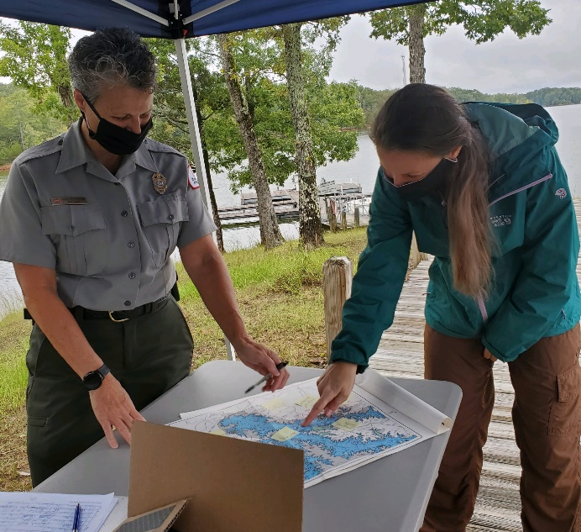
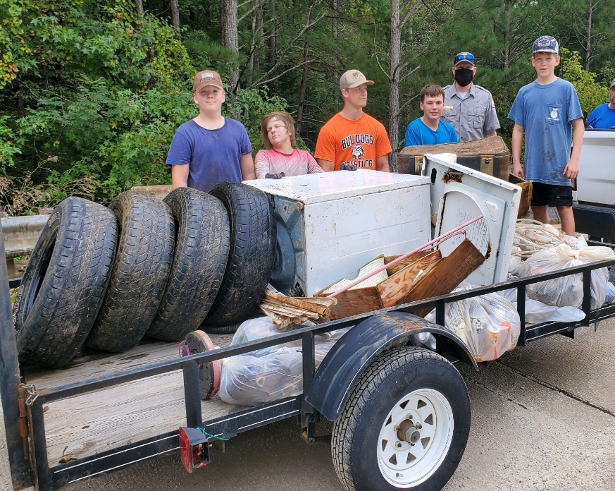
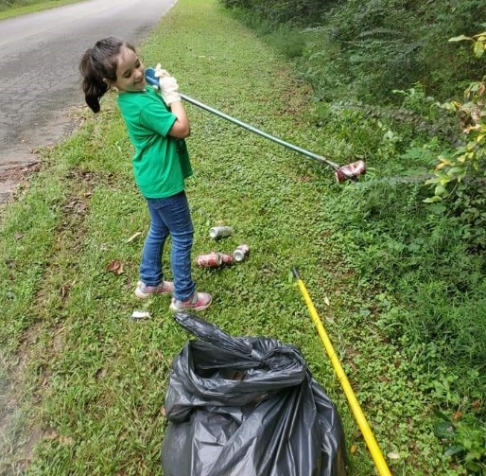
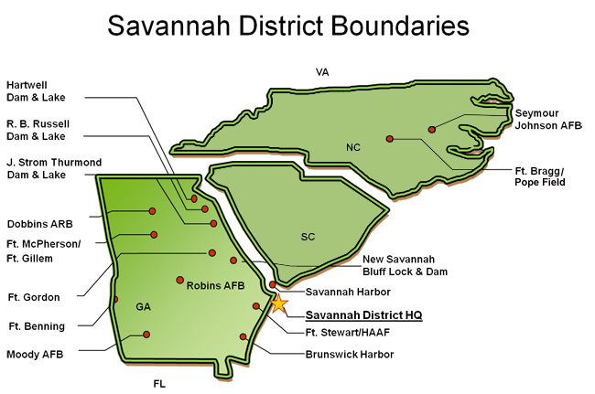
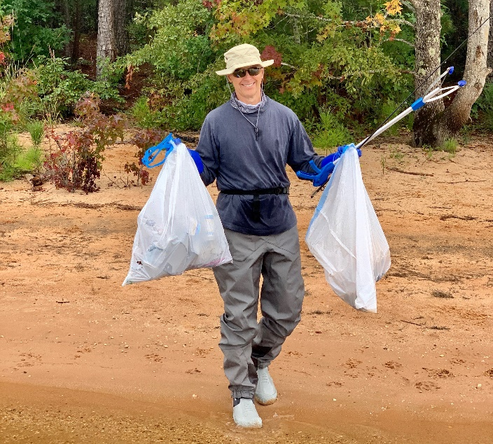
SAVANNAH DISTRICT:
Russell NPLD Cleanup 2020 “COVID Style” 26 September 2020
COVID may have stopped some at Russell from participating in this year’s cleanup but it didn’t stop all! 46 participants came out and scoured the shoreline and islands for trash. Over 100 bags were collected along with tires and even a washing machine. Nearly 4000lbs of trash was removed in less than 3 hours time! Success!
Left-Park Ranger Annette Dotson assigns an area
Above-Park Ranger Charlie Todd and local youth pose with a trailer that was heaped over by lunch!

